Slide 1
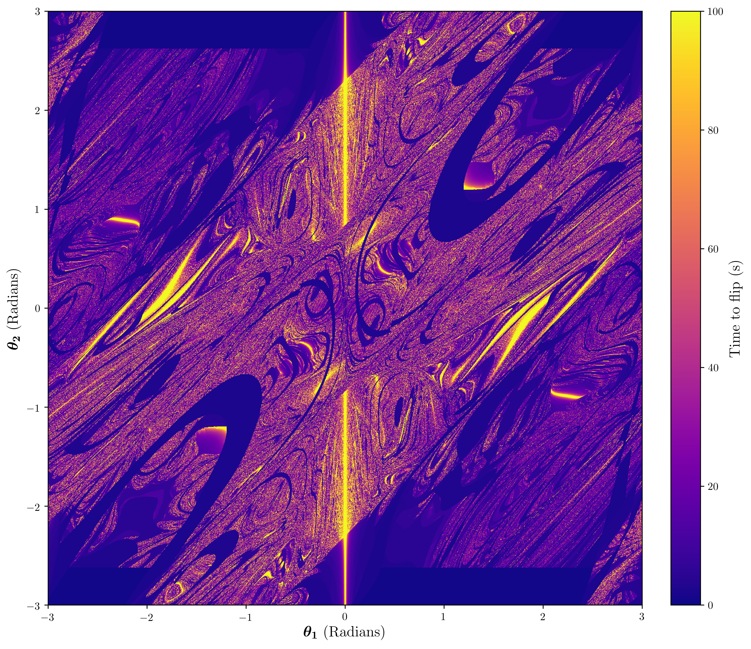
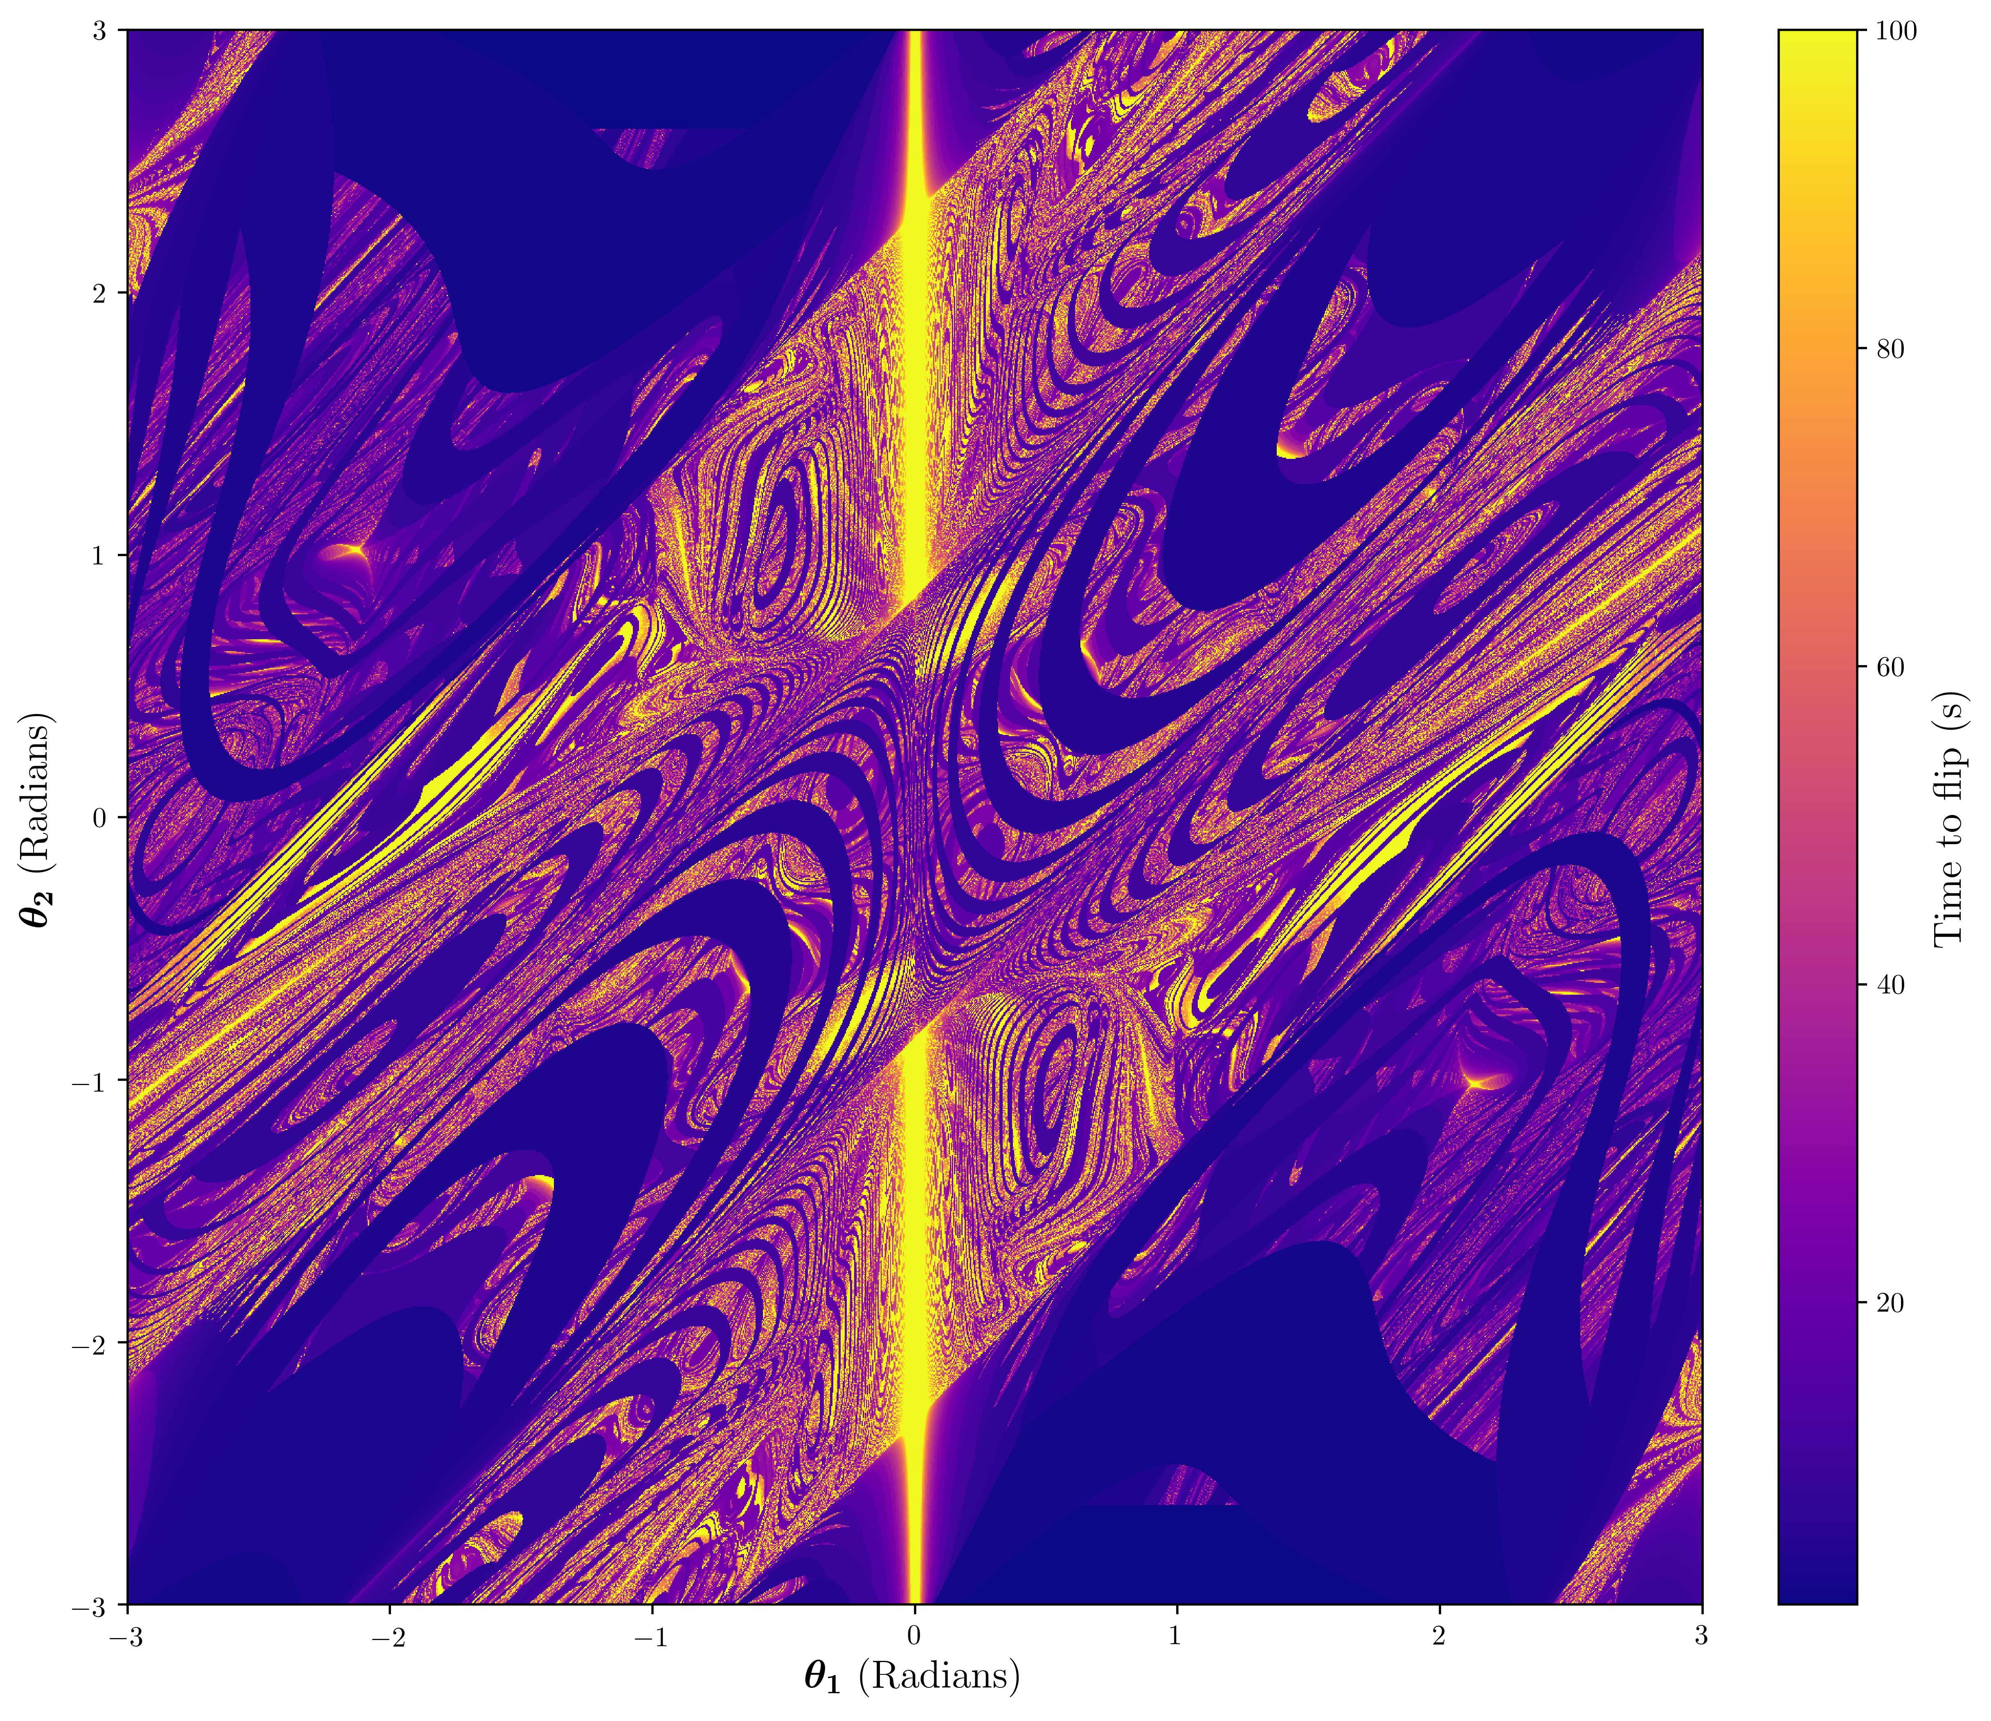
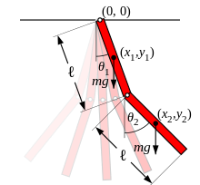
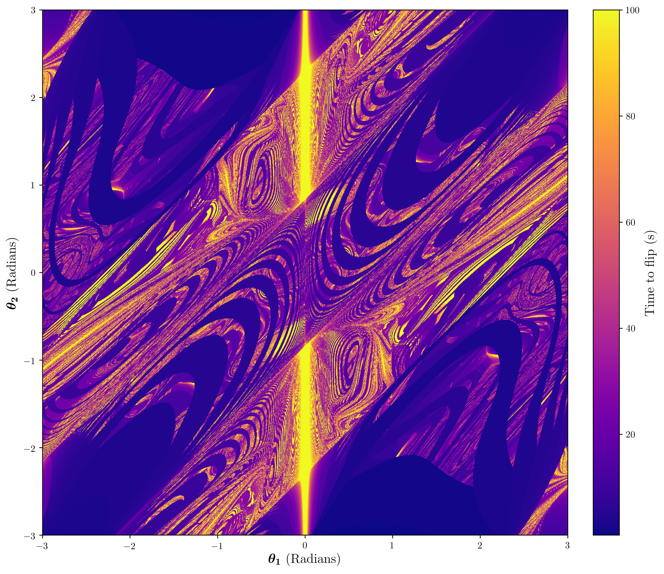
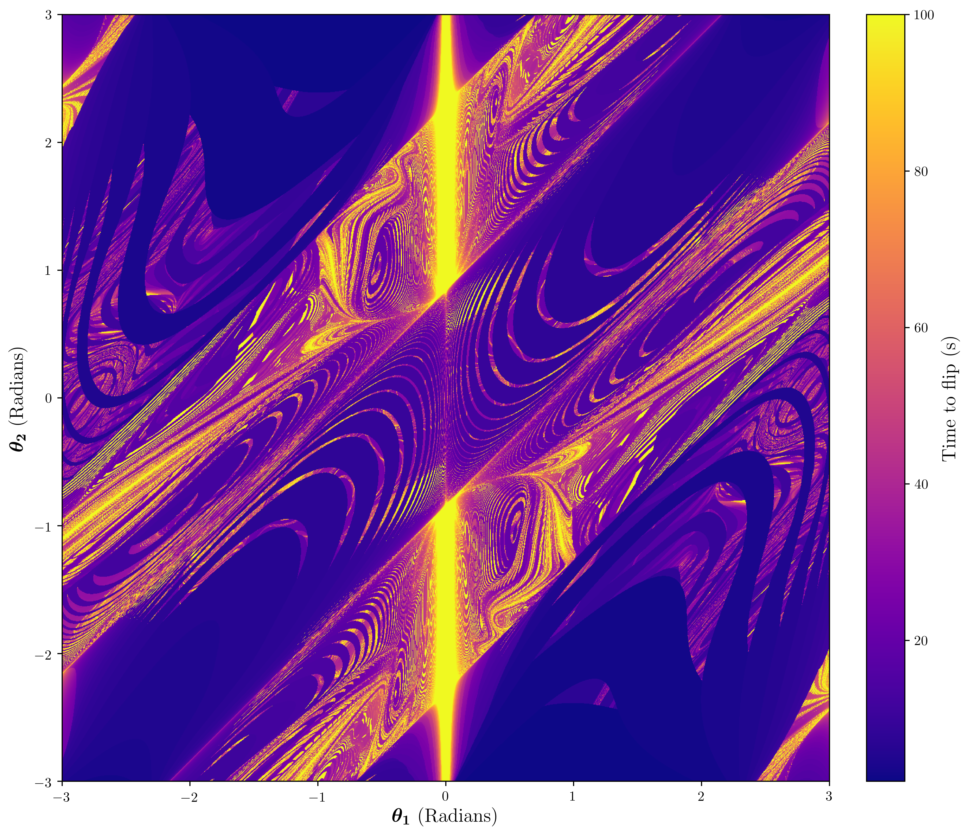
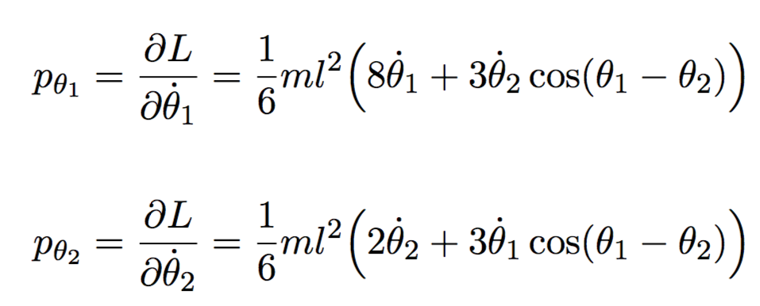
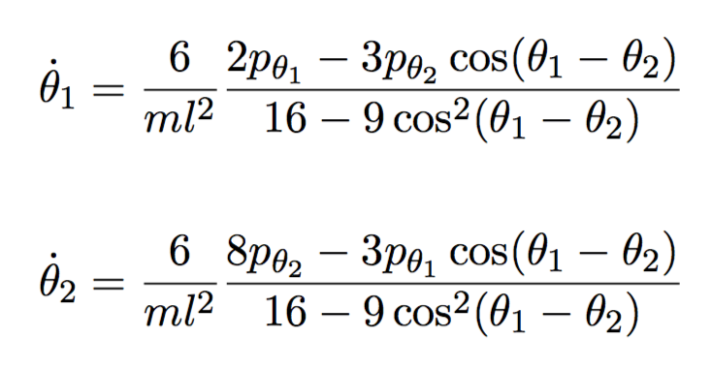
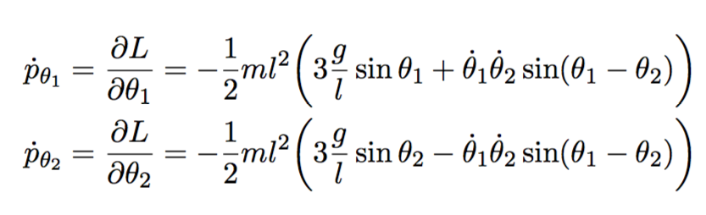
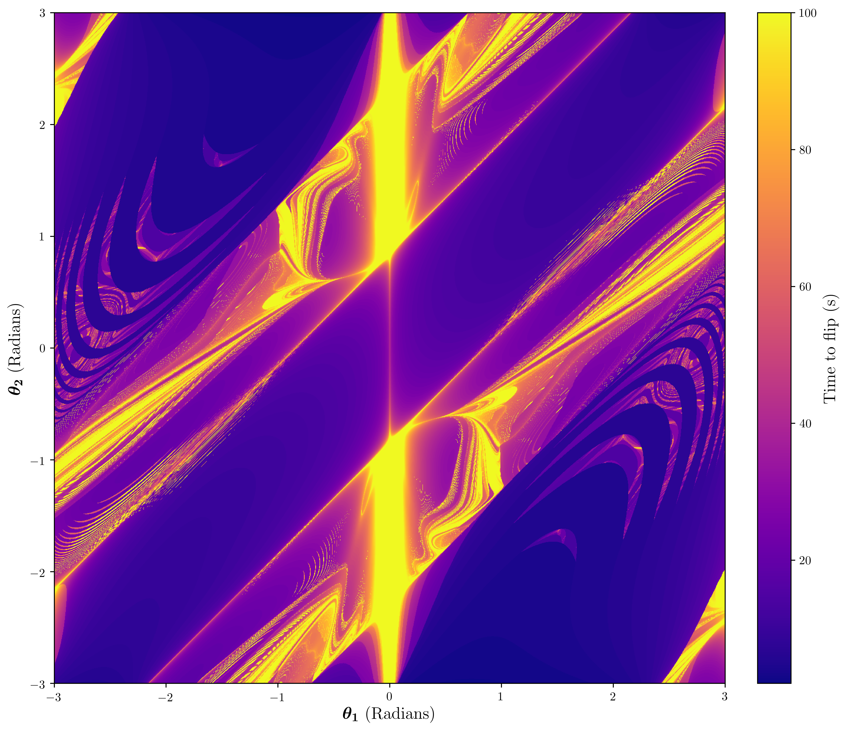
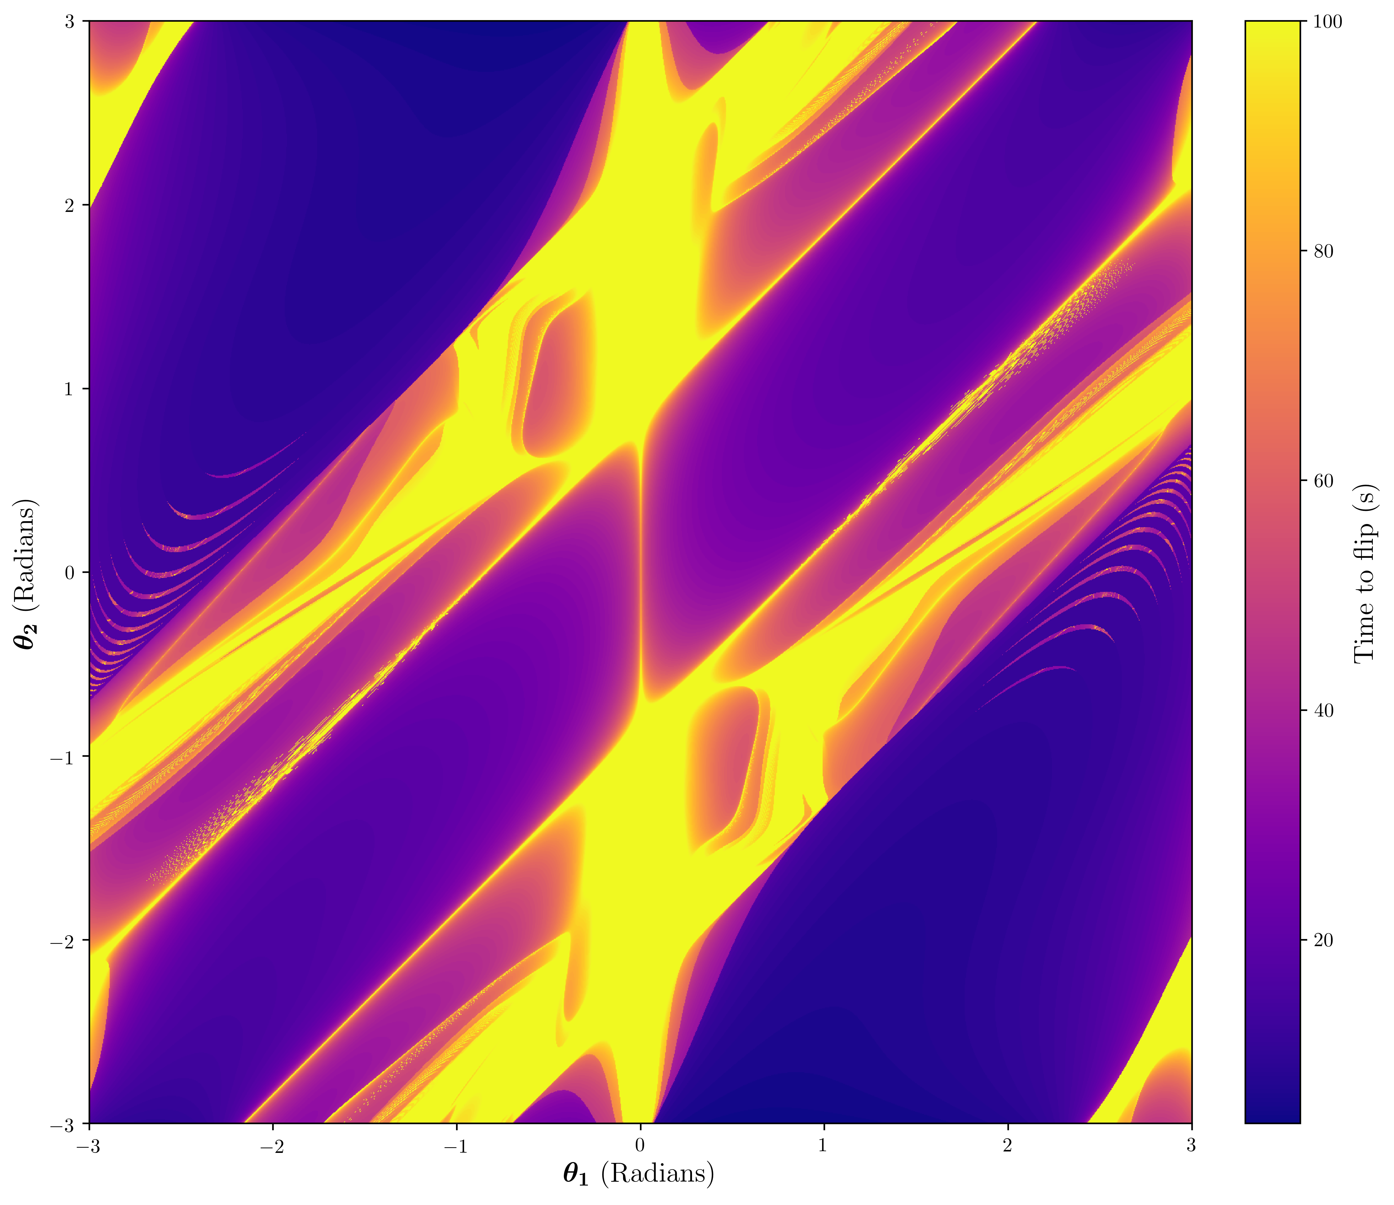
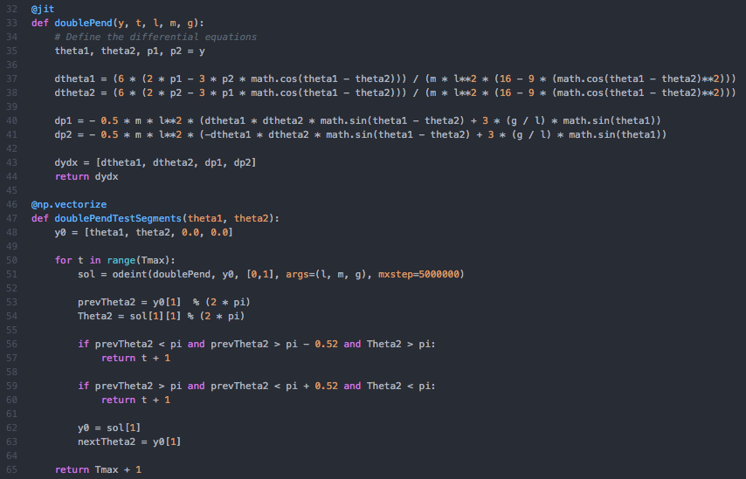
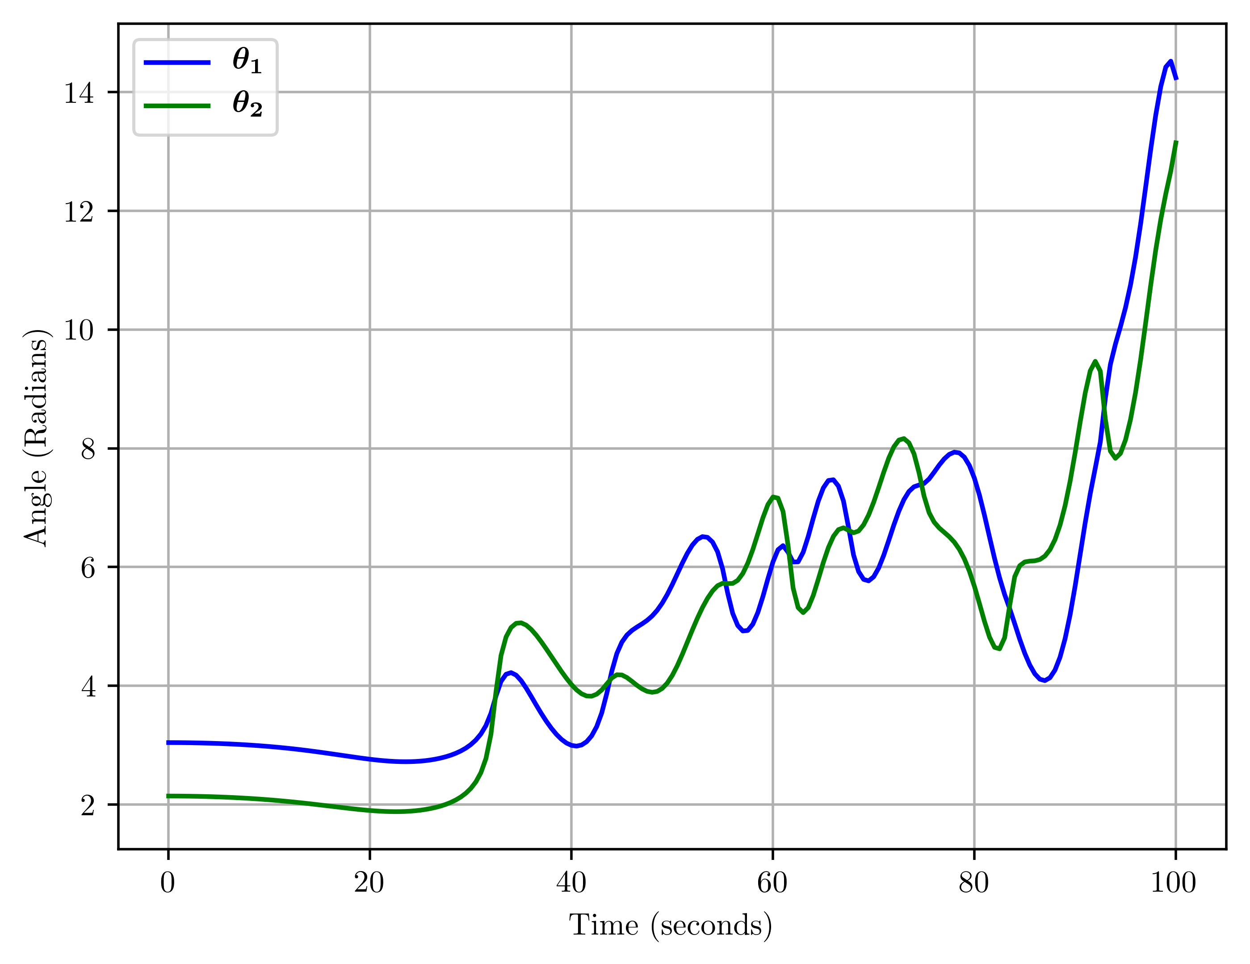
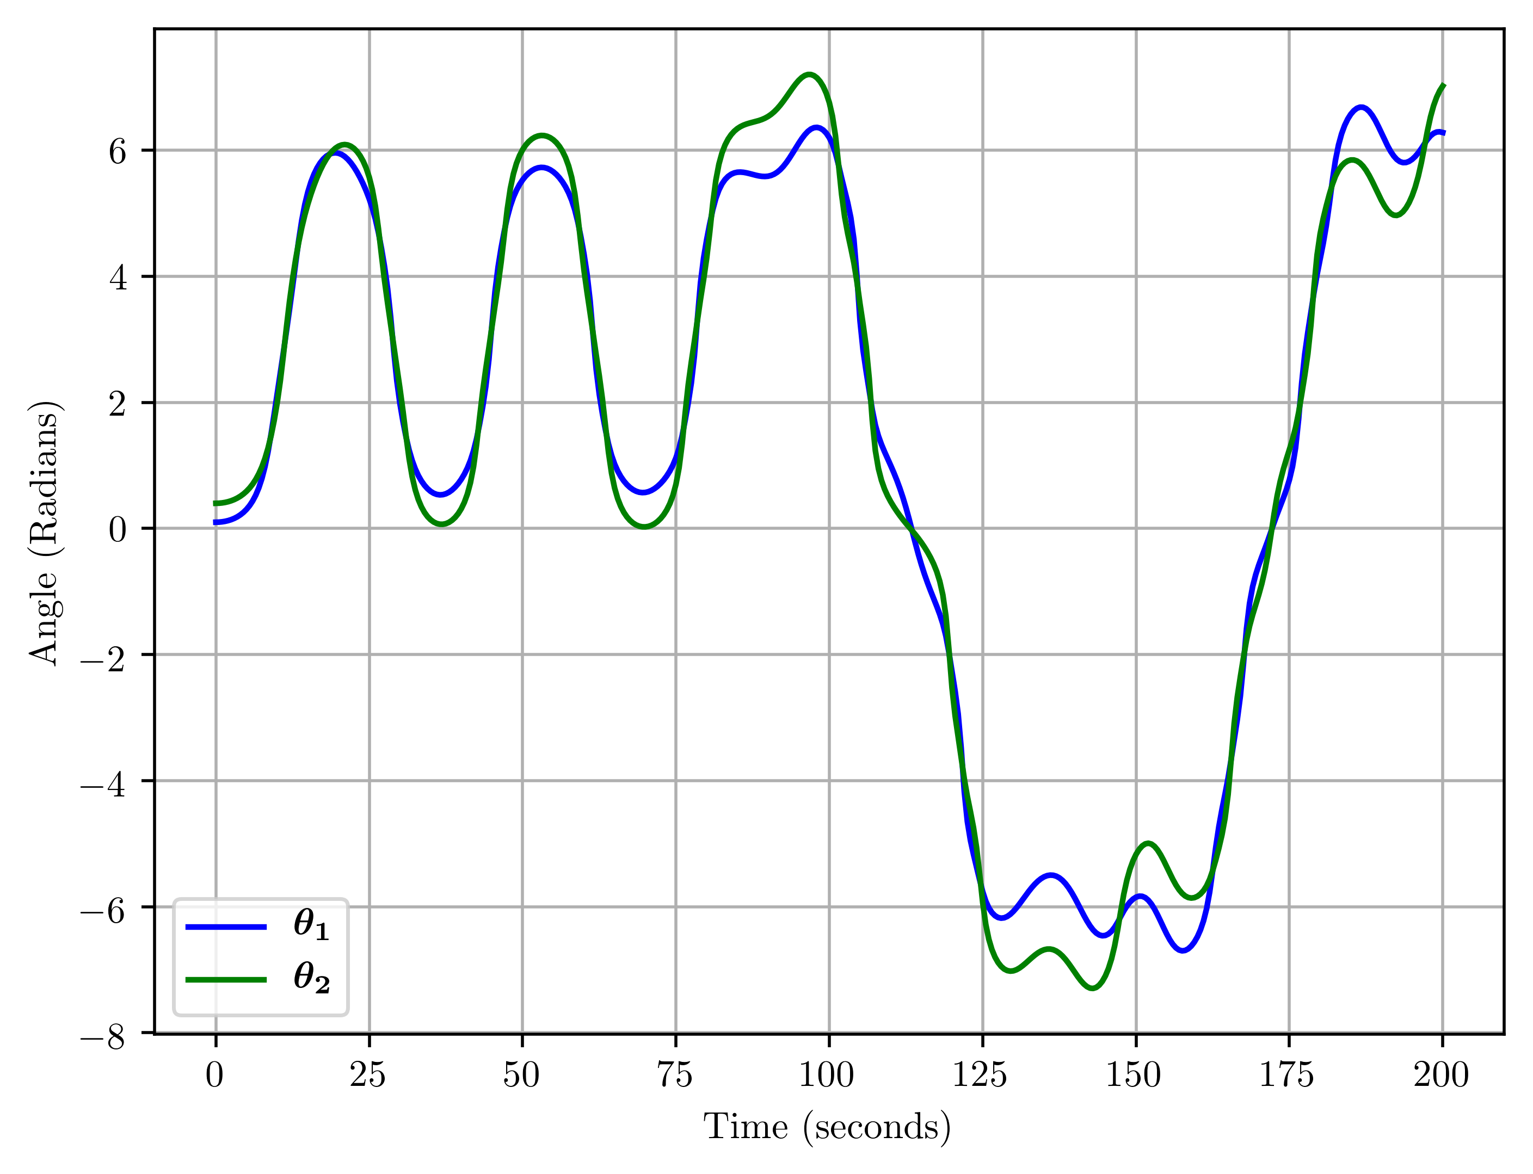
The Hidden Beauty of the Double Pendulum
Josh Greensmith
Colour Maps
The chaotic nature of the system is shown as two close starting conditions show a divergence in the outcome
l = 3, m = 1
l = 30, m = 1
Characteristic Equations
l = 50, m = 1
l = 100, m = 1
Numerical Integration Code in Python
Example graphs of the double pendulum developing with time
l = 300, m = 1
l = 1000, m = 1
Conclusion:
Chaotic systems do exhibit some patterns and symmetry.
The double pendulum system generates regimes when flip times is measured based on starting angles
ODE system which is solved numerically using the scipy.odeint package

